Slide 1

Cube Game
Game Store

Slide 2
Our Team
Hossam Mohamed
Yasmeen Ahmed
Hend shaker
Nancy Nagy
Esraa Magdy
Mariam Mohamed

Slide 3

A game store application is a software program that allows users to browse, purchase, and download video games. Once a user has chosen a game, they can purchase it through the application using a variety of payment methods. Once the purchase is complete, the game is typically downloaded directly to the user's device.
Some popular examples of game store applications include Steam, Epic Games Store.

Slide 4
WHO CAN USE IT
ADMIN
USER
Can add, update, delete (Product - Category)
Can browse products, add items to cart, and make purchases

Slide 5
FUNCTION REQUIREMENTS
MUST HAVE
GOOD HAVE
MAY HAVE
Genres type - product name – product description and properties - Product Rate
Shop by (genres - lists), Add to (cart – wishlist), library,
Filter by (genre - developer - price), Search filter by product name
Show cart items with total price, Select payment using strip
Registration by Google, View products in discover and browse format
Product Image Slider, Show product price before and after discount
Add and continue shopping, Add trailer to each product
Hot add (Wishlist – cart) buttons also create counter on both
Support Live Chat
user reviews by rates and comments
Promos code and general coupons for discount
Contact Us apply form for any issues in game

Slide 6
TOOLS
UI/UX Design
Front-End
Back-End
Adobe Xd
HTML – CSS – JS – Bootstrap – Angular
ASP.Net Core Web API
?
?
?

Slide 7
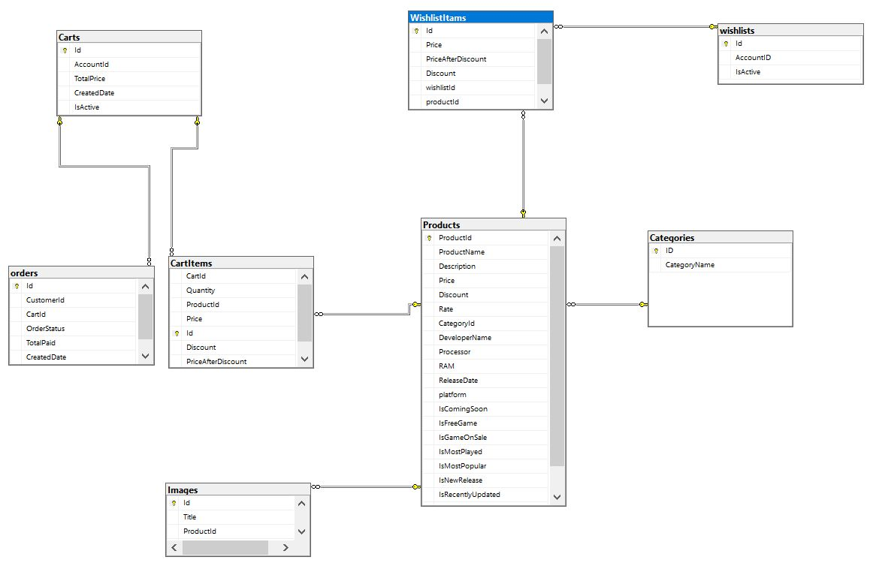
ERD

Slide 8
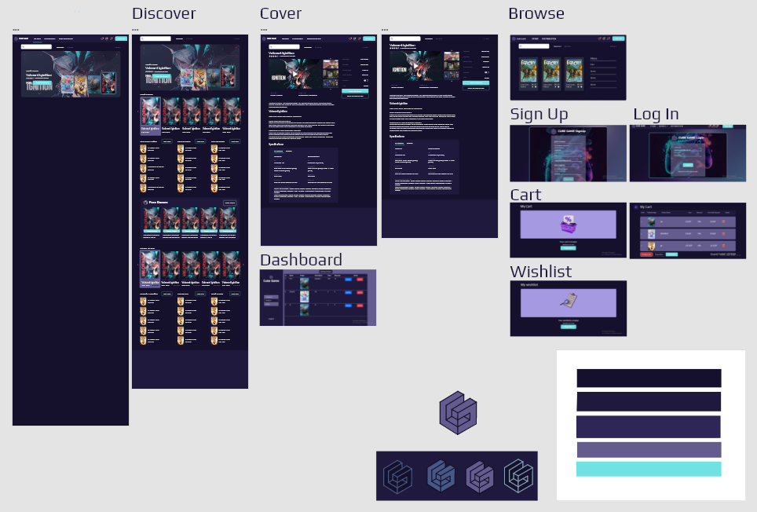
UI DESIGN PAGES

